Slide 1
Training Transformers from Scratch
Natural Language Processing with Transformers
Building Language Applications with Hugging Face
이용환

Slide 2
Introduction
Feedbacks & AI based auto sourcecode complete tool

Slide 3
Custom Dataset
Large dataset and Building a custom code dataset

Slide 4
Challenges of Building a Large-Scale Corpus
Pretraining 후 Model의 quality는 대규모 corpus의 quality에 의한 영향을 크게 받는다.
GPT가 학습한 BookCorpus의 경우, “romance” 장르로 편중되어 있고, GPT-2는 Web pages, blog, news article 등의 data로 pretraining을 진행하였다.
먼저 GPT 모델과 가장 작은 GPT-2 모델의 크기가 대략 비슷함.
Code
from transformers import pipeline, set_seed
generation_gpt = pipeline("text-generation", model="openai-gpt")
generation_gpt2 = pipeline("text-generation", model="gpt2")
def model_size(model):
return sum(t.numel() for t in model.parameters())
print(f"GPT size: {model_size(generation_gpt.model)/1000**2:.1f}M parameters")
print(f"GPT2 size: {model_size(generation_gpt2.model)/1000**2:.1f}M parameters")
Output
GPT size: 116.5M parameters
GPT2 size: 124.4M parameters

Slide 5
Challenges of Building a Large-Scale Corpus
Pretraining 후 Model의 quality는 대규모 corpus의 quality에 의한 영향을 크게 받는다.
GPT가 학습한 BookCorpus의 경우, “romance” 장르로 편중되어 있고, GPT-2는 Web pages, blog, news article 등의 data로 pretraining을 진행하였다.
먼저 GPT 모델과 가장 작은 GPT-2 모델의 크기가 대략 비슷함.
Code
set_seed(1)
def enum_pipeline_ouputs(pipe, prompt, num_return_sequences):
out = pipe(prompt, num_return_sequences=num_return_sequences,
clean_up_tokenization_spaces=True)
return "\n".join(f"{i+1}." + s["generated_text"] for i, s in enumerate(out))
prompt = "\nWhen they came back"
print("GPT completions:\n" + enum_pipeline_ouputs(generation_gpt, prompt, 3))
print("")
print("GPT-2 completions:\n" + enum_pipeline_ouputs(generation_gpt2, prompt, 3))

Slide 6
Challenges of Building a Large-Scale Corpus
Output
GPT completions:
1.
When they came back.
" we need all we can get, " jason said once they had settled into the back of the truck without anyone stopping them. " after getting out here, it 'll be up to us what to find. for now
2.
When they came back.
his gaze swept over her body. he 'd dressed her, too, in the borrowed clothes that she 'd worn for the journey.
" i thought it would be easier to just leave you there. " a woman like
3.
When they came back to the house and she was sitting there with the little boy.
" don't be afraid, " he told her. she nodded slowly, her eyes wide. she was so lost in whatever she discovered that tom knew her mistake
GPT-2 completions:
1.
When they came back we had a big dinner and the other guys went to see what their opinion was on her. I did an hour and they were happy with it.
2.
When they came back to this island there had been another massacre, but he could not help but feel pity for the helpless victim who had been left to die, and that they had failed that day. And so was very, very grateful indeed.
3.
When they came back to our house after the morning, I asked if she was sure. She said, "Nope." The two kids were gone that morning. I thought they were back to being a good friend.
When Dost

Slide 7
Challenges of Building a Large-Scale Corpus
Output
GPT completions:
1.
When they came back.
" we need all we can get, " jason said once they had settled into the back of the truck without anyone stopping them. " after getting out here, it 'll be up to us what to find. for now
2.
When they came back.
his gaze swept over her body. he 'd dressed her, too, in the borrowed clothes that she 'd worn for the journey.
" i thought it would be easier to just leave you there. " a woman like
3.
When they came back to the house and she was sitting there with the little boy.
" don't be afraid, " he told her. she nodded slowly, her eyes wide. she was so lost in whatever she discovered that tom knew her mistake
GPT-2 completions:
1.
When they came back we had a big dinner and the other guys went to see what their opinion was on her. I did an hour and they were happy with it.
2.
When they came back to this island there had been another massacre, but he could not help but feel pity for the helpless victim who had been left to die, and that they had failed that day. And so was very, very grateful indeed.
3.
When they came back to our house after the morning, I asked if she was sure. She said, "Nope." The two kids were gone that morning. I thought they were back to being a good friend.
When Dost
Romantic interaction
Adventure-related elements

Slide 8
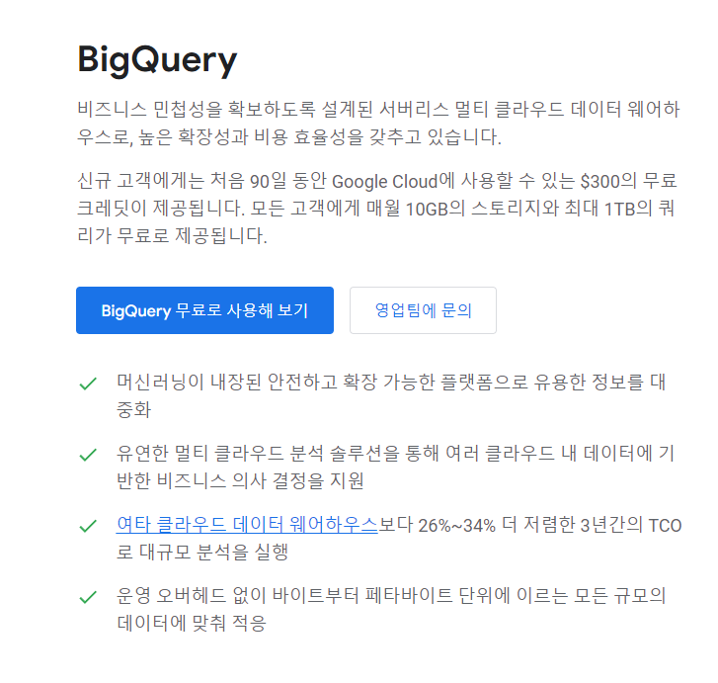
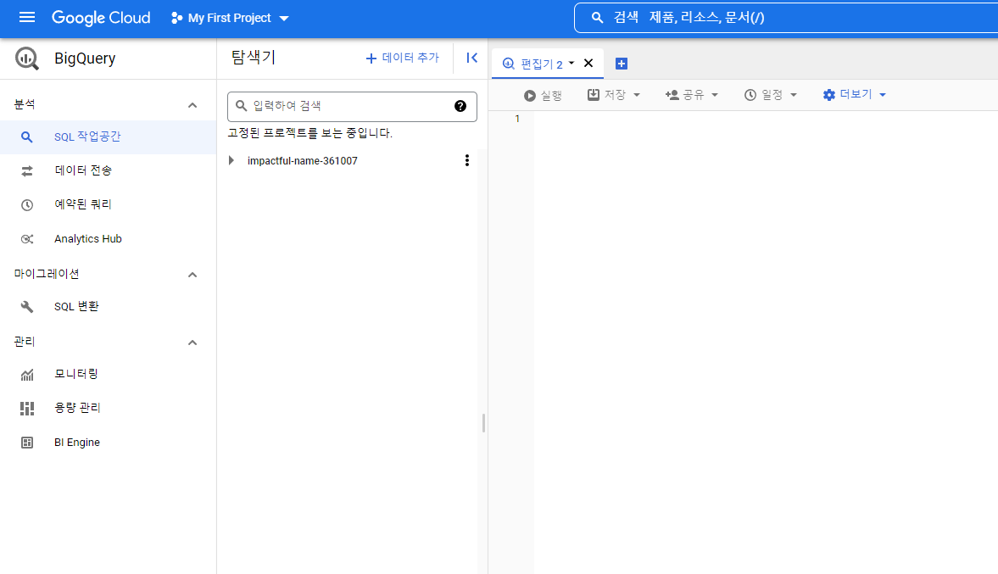
Building a Custom Code Dataset
책에서는 Python code generation model을 위한 Dataset을 만들기로 함.
Github repository에서 source code data를 얻고, Google BigQuery를 활용하기로 함.

Slide 9
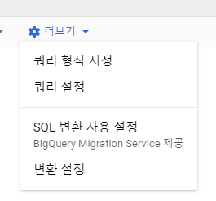
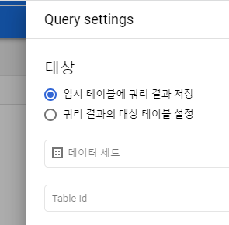
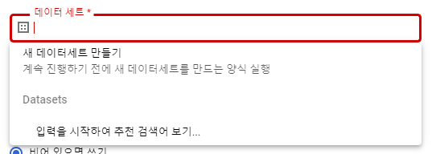
Building a Custom Code Dataset
책에서는 Python code generation model을 위한 Dataset을 만들기로 함.
Github repository에서 source code data를 얻고, Google BigQuery를 활용하기로 함.

Slide 10
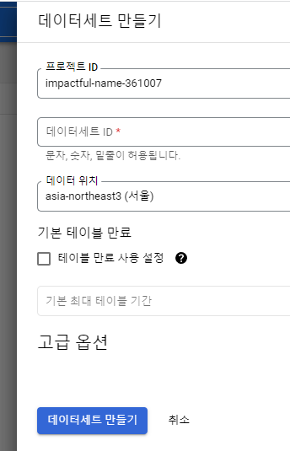
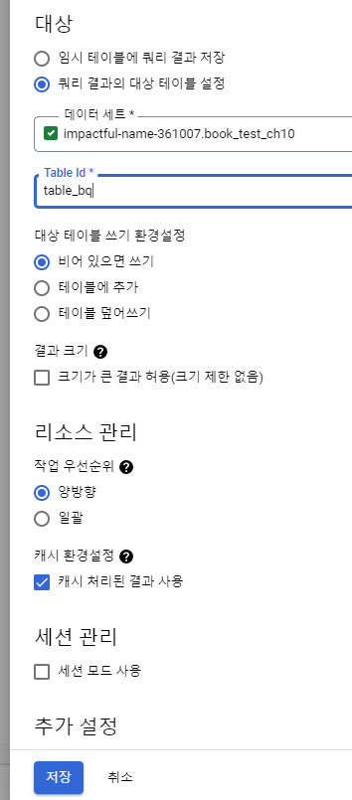
Building a Custom Code Dataset
책에서는 Python code generation model을 위한 Dataset을 만들기로 함.
Github repository에서 source code data를 얻고, Google BigQuery를 활용하기로 함.

Slide 11
Building a Custom Code Dataset
책에서는 Python code generation model을 위한 Dataset을 만들기로 함.
Github repository에서 source code data를 얻고, Google BigQuery를 활용하기로 함.
Code
SELECT
f.repo_name, f.path, c.copies, c.size, c.content, l.license
FROM
`bigquery-public-data.github_repos.files` AS f
JOIN
`bigquery-public-data.github_repos.contents` AS c
ON
f.id = c.id
JOIN
`bigquery-public-data.github_repos.licenses` AS l
ON
f.repo_name = l.repo_name
WHERE
NOT c.binary
AND ((f.path LIKE '%.py')
AND (c.size BETWEEN 1024
AND 1048575))

Slide 12
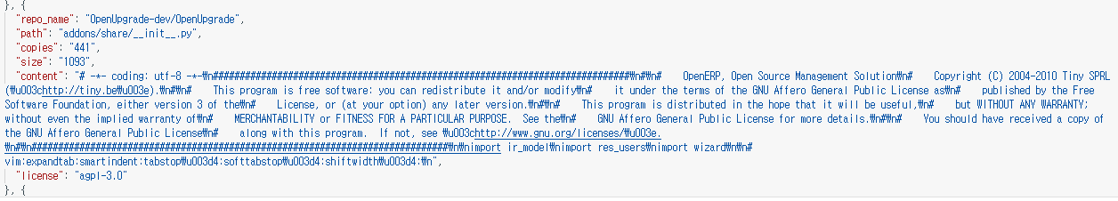
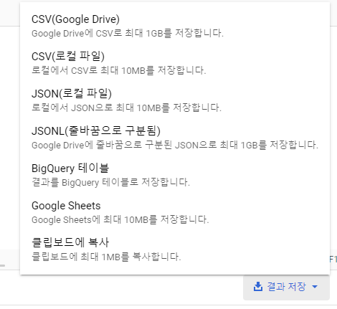
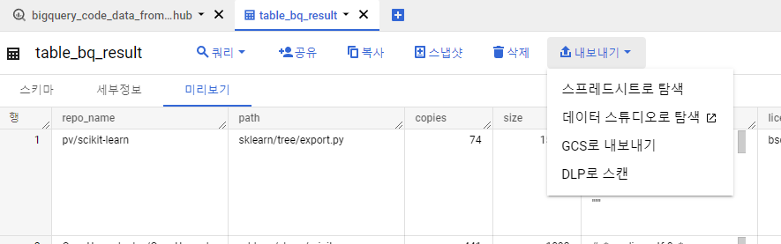
Building a Custom Code Dataset
Output

Slide 13
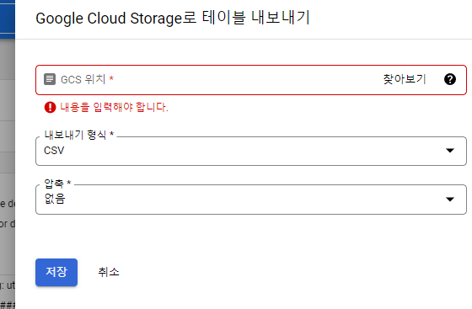
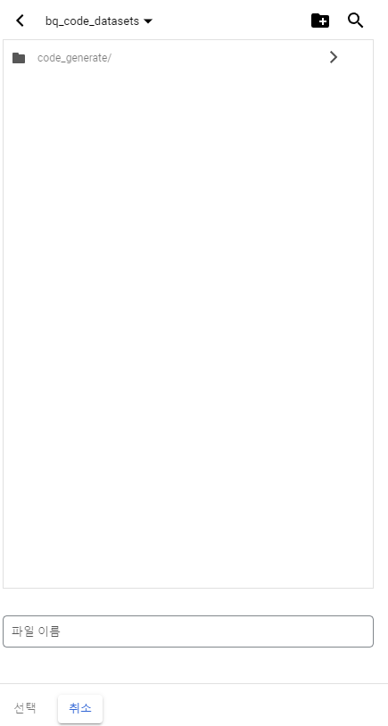
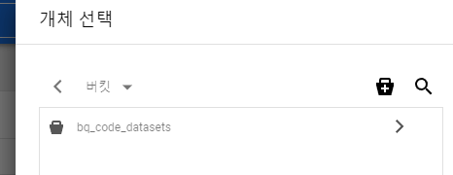
Building a Custom Code Dataset

Slide 14
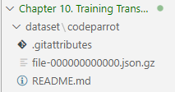
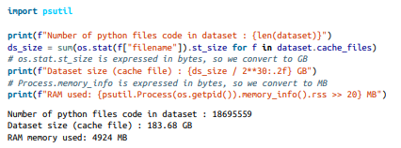
Building a Custom Code Dataset
‘내보내기’ 후에 gsutil 설치(pip install gsutil)
gsutil config에 Google 계정 등록 -> bucket을 컴퓨터에 copy
혹은 제일 간단한 방법 : “git clone https://huggingface.co/datasets/transformersbook/codeparrot”
위 사진과 같이 file-000000000000.json.gz부터 499번까지 총 183.68GB

Slide 15
Building a Tokenizer

Slide 16
Building a Tokenizer
Code
# hide_output
from transformers import AutoTokenizer
def tok_list(tokenizer, string):
input_ids = tokenizer(string, add_special_tokens=False)["input_ids"]
return [tokenizer.decode(tok) for tok in input_ids]
tokenizer_T5 = AutoTokenizer.from_pretrained("t5-base")
tokenizer_camembert = AutoTokenizer.from_pretrained("camembert-base")
print(f'T5 tokens for "sex": {tok_list(tokenizer_T5,"sex")}')
print(f'CamemBERT tokens for "being": {tok_list(tokenizer_camembert,"being")}')
Output
T5 tokens for "sex": ['', 's', 'ex']
CamemBERT tokens for "being": ['be', 'ing']

Slide 17
Building a Tokenizer
Code
from transformers import AutoTokenizer
python_code = r"""def say_hello():
print("Hello, World!")
# Print it
say_hello()
"""
tokenizer = AutoTokenizer.from_pretrained("gpt2")
print(tokenizer(python_code).tokens())
Output
['def', 'Ġsay', '_', 'hello', '():', 'Ċ', 'Ġ', 'Ġ', 'Ġ', 'Ġprint', '("', 'Hello', ',', 'ĠWorld', '!"', ')', 'Ċ', '#', 'ĠPrint', 'Ġit', 'Ċ', 'say', '_', 'hello', '()', 'Ċ']

Slide 18
Building a Tokenizer
Code
tokenizer.backend_tokenizer.normalizer
Output
None
현재 어떤 방식으로 normalize되어 있는지 확인
GPT-2 Tokenizer는 normalization을 사용하지 않았음.

Slide 19
Building a Tokenizer
Code
a, e = u"a", u"€"
byte = ord(a.encode("utf-8"))
print(f'`{a}` is encoded as `{a.encode("utf-8")}` with a single byte: {byte}')
byte = [ord(chr(i)) for i in e.encode("utf-8")]
print(f'`{e}` is encoded as `{e.encode("utf-8")}` with three bytes: {byte}')
Output
`a` is encoded as `b'a'` with a single byte: 97
`€` is encoded as `b'\xe2\x82\xac'` with three bytes: [226, 130, 172]
Byte level로 글자를 Tokenization할 때, 어떤 식으로 숫자로 표현되는지 확인
Ex) a -> b‘a’(UTF-8로 표현) -> 97

Slide 20
Training a Model from Scratch

